Slide 1
Customer Shopping Behavior Analysis
Uncovering insights from 3,900 purchases to guide strategic business decisions through data-driven analysis of spending patterns, customer segments, and product preferences.

Slide 2
Understanding Our Data Foundation
Dataset Overview
3,900 Total Purchases Transactions analyzed across all categories | 18 Data Columns Features tracking customer behavior | 37 Missing Values Only in Review Rating column
Customer Demographics Age, Gender, Location Subscription Status | Shopping Behavior Purchase patterns and frequency Discount usage and ratings

Slide 3
Python Analysis
Data Preparation & Cleaning
1. Data Loading & Exploration
Imported dataset using pandas, examined structure with df.info() and summary statistics with df.describe()
2. Missing Data Handling
Imputed 37 missing Review Rating values using median rating per product category
3. Feature Engineering
Created age_group bins and purchase_frequency_days columns for deeper insights
4. Database Integration
Connected to PostgreSQL and loaded cleaned data for SQL analysis

Slide 4
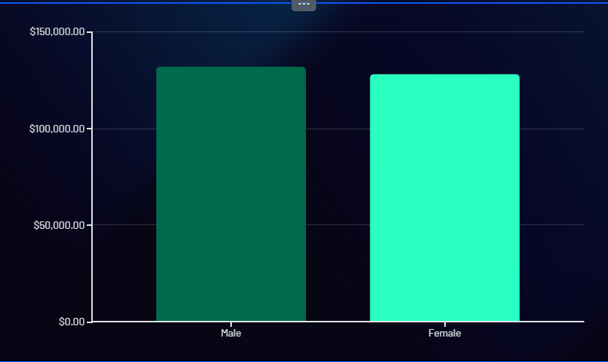
Revenue Insights by Gender
 | Balanced Revenue Male and female customers contribute nearly equal revenue, indicating broad market appeal across genders with no significant skew in purchasing power.

Slide 5

Key Findings
Customer Behavior Patterns
Smart Discount Users High-spending customers still use discounts but maintain above-average purchase amounts
Top-Rated Products Identified products with highest average review ratings driving customer satisfaction
Shipping Preferences Express shipping users show higher average purchase amounts compared to standard

Slide 6
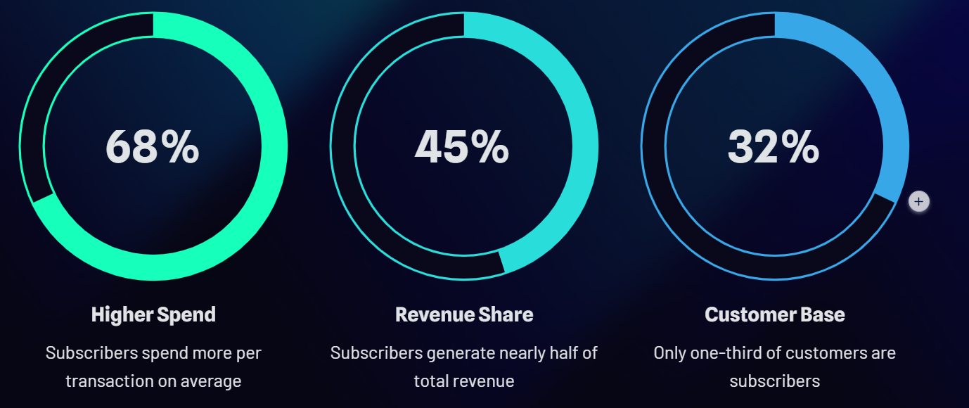
Subscription Impact Analysis
Key Insight: Subscribers represent a smaller customer base but drive disproportionately higher revenue—a critical growth opportunity.

Slide 7

Customer Segmentation Strategy
Repeat Buyer Insight Customers with 5+ purchases show significantly higher subscription rates, indicating loyalty correlation. | Growth Opportunity Moving customers from New to Returning segments should be a priority focus area.

Slide 8
Product Analysis
Top Performers by Category
1
Clothing Blouse leads with highest purchase volume, followed by Dress and Shirt
2
Accessories Jewelry dominates category sales, with Sunglasses and Handbag close behind
3
Footwear Sneakers are most popular, followed by Sandals and Boots
Discount-Dependent Products: Three items show highest percentage of discounted purchases, suggesting price sensitivity in specific categories.

Slide 9
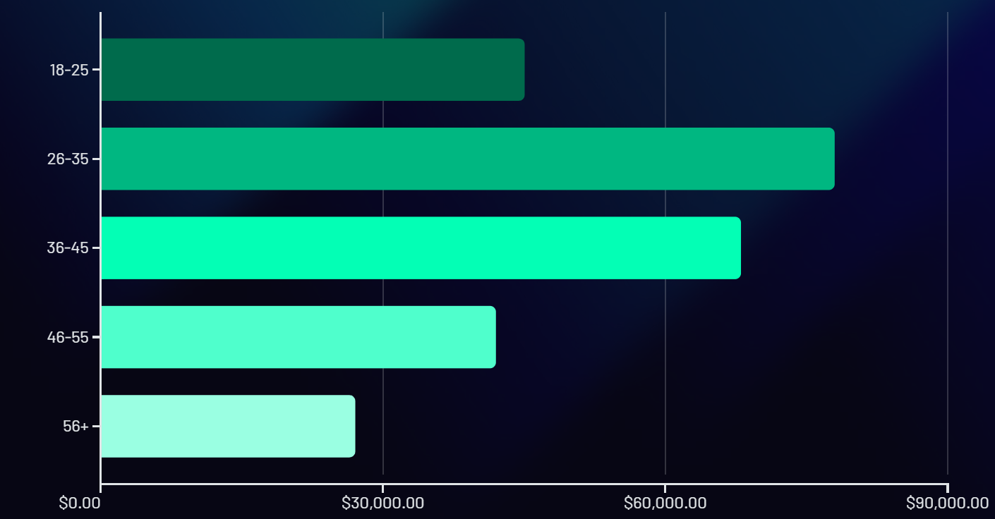
Revenue by Age Group
The 26-35 age group drives the highest revenue contribution, representing the core target demographic. Marketing efforts should prioritize this segment while developing strategies to engage adjacent age groups.

Slide 10

Strategic Recommendations
Business Action Plan
Boost Subscriptions
Promote exclusive benefits and perks to convert high-value customers into subscribers
Loyalty Programs
Reward repeat buyers to accelerate movement into "Loyal" customer segment
Optimize Discounts
Balance promotional sales boosts with margin control for sustainable growth
Targeted Marketing
Focus campaigns on high-revenue age groups (26-35) and express-shipping users

